Slide 1
Illness Detection
Group 1:
Trevon Woods
Aima Ayaz
Waseem Basit
Mohammed Farooq Abdullah

Slide 2
Goal
Company Name
Quarter
Month Year

Slide 3
Goal
01. Identify potential sick individuals
02. Take Physiological Data from individuals
03. Use Logistic Regression to classify Data
04. Send Data to dashboard to further explore risks

Slide 4
Process Flow
Company Name
Quarter
Month Year
The system runs multiple data streams in parallel and synchronizes them into a single interface.

Slide 5
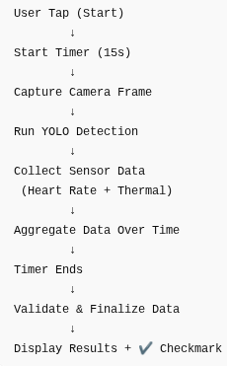
Flow

Slide 6
Problem & Solution
Company Name
Quarter
Month Year
This system acts as a first line of defense against illness transmission in shared environments.

Slide 7
Pre-Screening System for Early Illness Detection
Problem
During COVID-19 pandemic, illnesses spread rapidly in shared spaces like classrooms and offices
Individuals often entered environments without knowing they were sick
There was no simple, real-time screening system to identify potential illness before entry
Solution
A real-time monitoring system that:
Screens individuals before entering a space
Combines visual detection + physiological signals
Provides immediate feedback to the operator

Slide 8
Pre-Screening System for Early Illness Detection
Outcome / Impact
Helps identify potentially sick individuals early
Enables preventative action before exposure occurs
Supports safer environments in:
Classrooms
Offices
Public spaces
Key Factors
Detects individuals using computer vision (YOLO)
Measures temperature using thermal sensing
Monitors heart rate using a pulse sensor
Collects data over a short time window for reliability
Interactive interface for controlled screening

Slide 9
Tech Stack
Company Name
Quarter
Month Year

Slide 10
Tech Stack
Model
Logistic Regression
Tools
3D Printer
Colab
VS Code
ChatGPT
Hardware
Raspberry PI
ProtoBoard
PI Camera Module
Thermal Sensor
Heart Beat Sensor
TouchScreen Display
Front-end
React
Database
MongoDB
Back-end
Node.js
Express
FastAPI
nGrok

Slide 11
DEMO
Company Name
Quarter
Month Year

Slide 12
CODE WALKTHROUGH
Company Name
Quarter
Month Year

Slide 13
Any questions? Ask away!

Slide 14
Thank you

